Slide 1
The Development and Current State of Basketball Analytics
Miles Kee

Slide 2

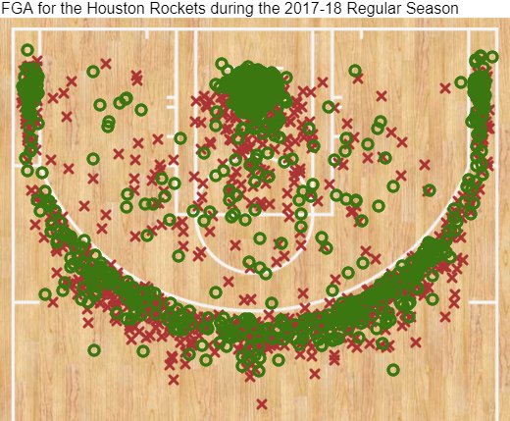
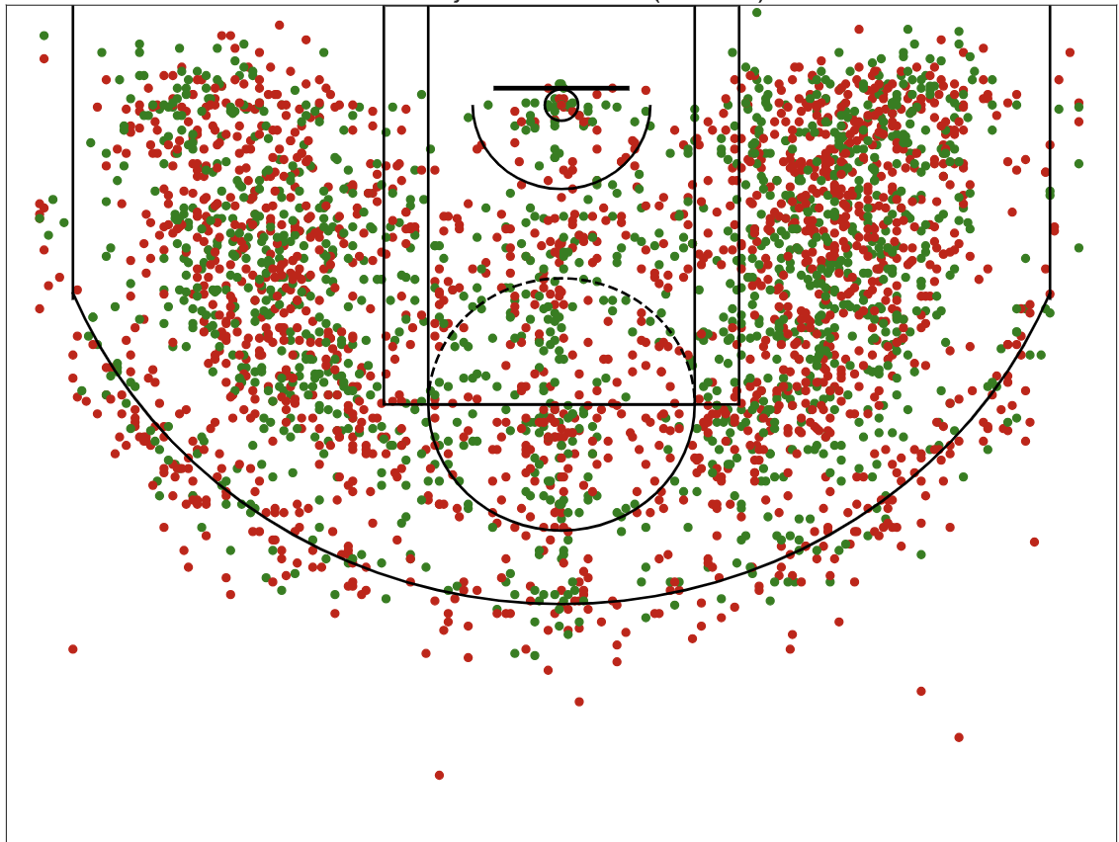




The Three Point Revolution

Slide 3
Basketball on Paper
Dean Oliver’s 2004 book on analyzing the game of basketball planted the seeds for the analytics revolution that would follow
The two biggest analytical concepts this book introduced were:
Offensive and defensive ratings
Evaluating teams via the four factors: EFG%, TO%, ORB%, FT/FGA

Slide 4
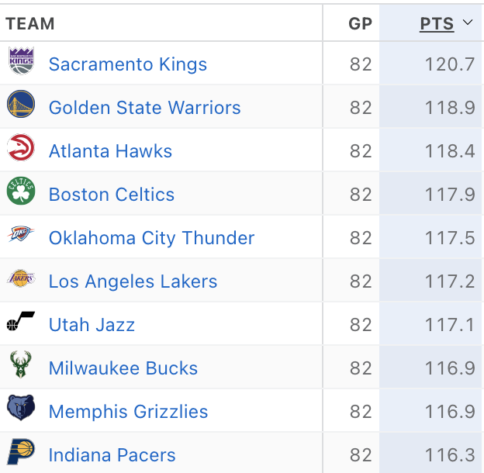
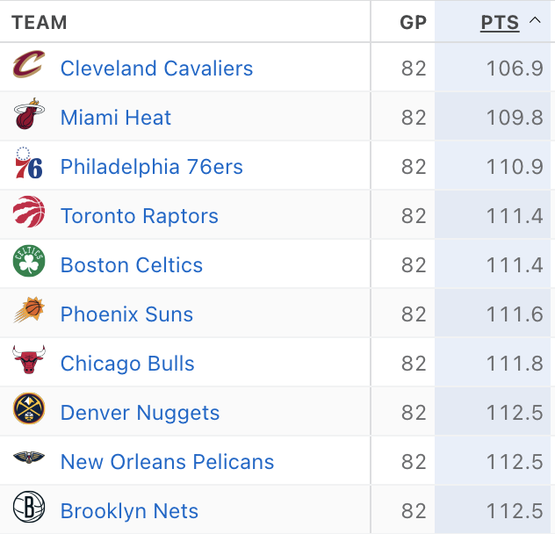
Offensive and Defensive Ratings
Early measures of NBA offenses and defenses were based on points scored per game and points allowed per game, respectively
Shown to the right are the top 10 teams in points scored (top) and allowed (bottom) for the 2022-23 NBA season
However, these metrics seem to have little correlation with team success, as 3 out of the top 10 offenses and 4 out of the top 10 defenses didn’t even make the playoffs last year

Slide 5
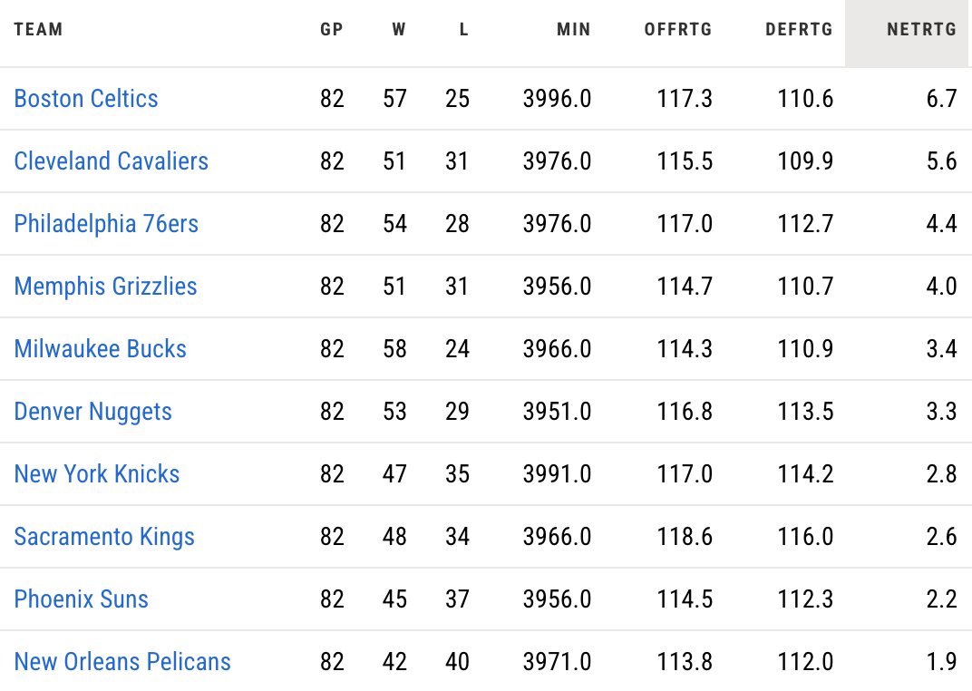
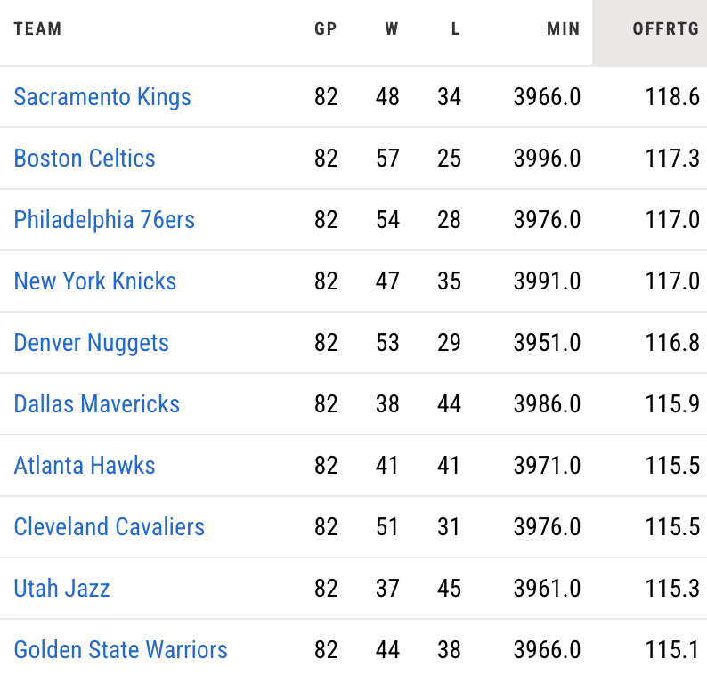
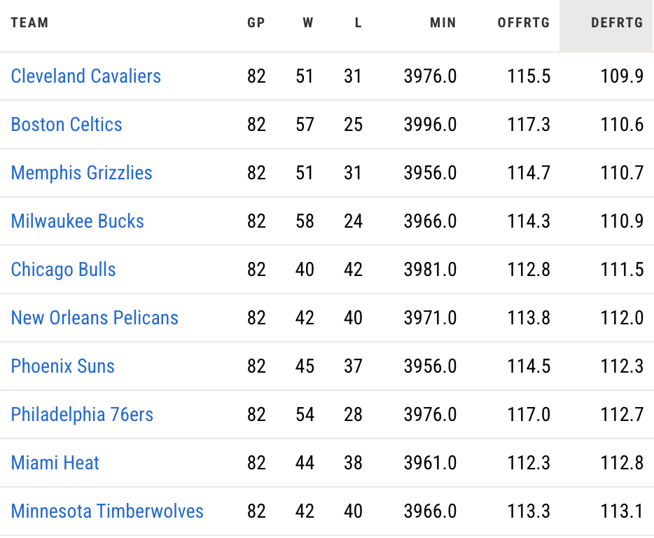
Offensive and Defensive Ratings
Offensive (bottom left) and defensive (bottom right) rating adjust raw scoring stats to the pace that a team played at
Teams that play at a faster pace will have more possessions in their, and therefore more opportunities to score/allow points
Offensive and defensive ratings take pace out of the equation by adjusting for how fast a team plays, and these stats can be read as points scored/allowed per 100 possessions
These statistics become even more predictive when combined to create net rating (offensive-defensive), shown at the top
Now, 8/10 of the top offenses, 8/10 of the top 10 defenses, and 9/10 of the top net rating teams made the playoffs

Slide 6
The Four Factors
Oliver also proposed that there were four factors that contributed to a team’s offensive and defensive rating:
Effective field goal percentage (EFG%): Measures a team’s shooting ability and is used in place of raw FG% because it adjusts for a team’s 3PT shooting ability
Turnover percentage (TO%): The percentage of a team’s possessions that end in a turnover
Offensive rebounding percentage (ORB%): The percentage of a team’s misses on offense that they rebound
Free throw rate (FT/FGA): This is a simple calculation that measures how many free throws a team shoots per each shot they take
These four metrics, when combined and weighted, are enough on their own to evaluate a team’s offense, and their reverses are enough to evaluate a team’s defense

Slide 7
The Four Factors
In the NBA, the four factors are not used often because the amount of games played in the NBA and the balanced schedule leads to stats needing little adjustment or context
Adjusting for possessions is often enough to give valuable insight into NBA offenses and defenses
In college basketball, however, the four factors are needed to properly evaluate teams
NCAA basketball scheduling is very imbalanced, and statistics need to be given a lot more context and adjustment because of this
Stats from college basketball are often adjusted for possessions and opponent strength
Oliver proposed the following relative weights for the four factors: .4*EFG+.25*TOV+.2*ORB+.15*FTR

Slide 8
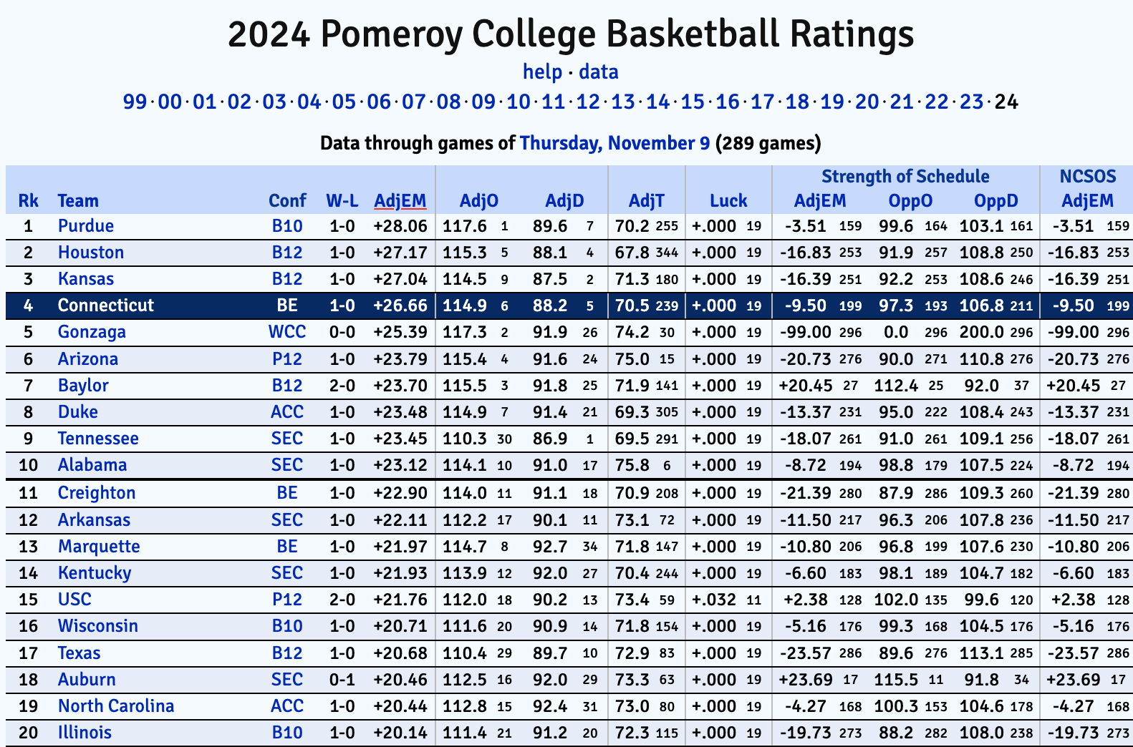
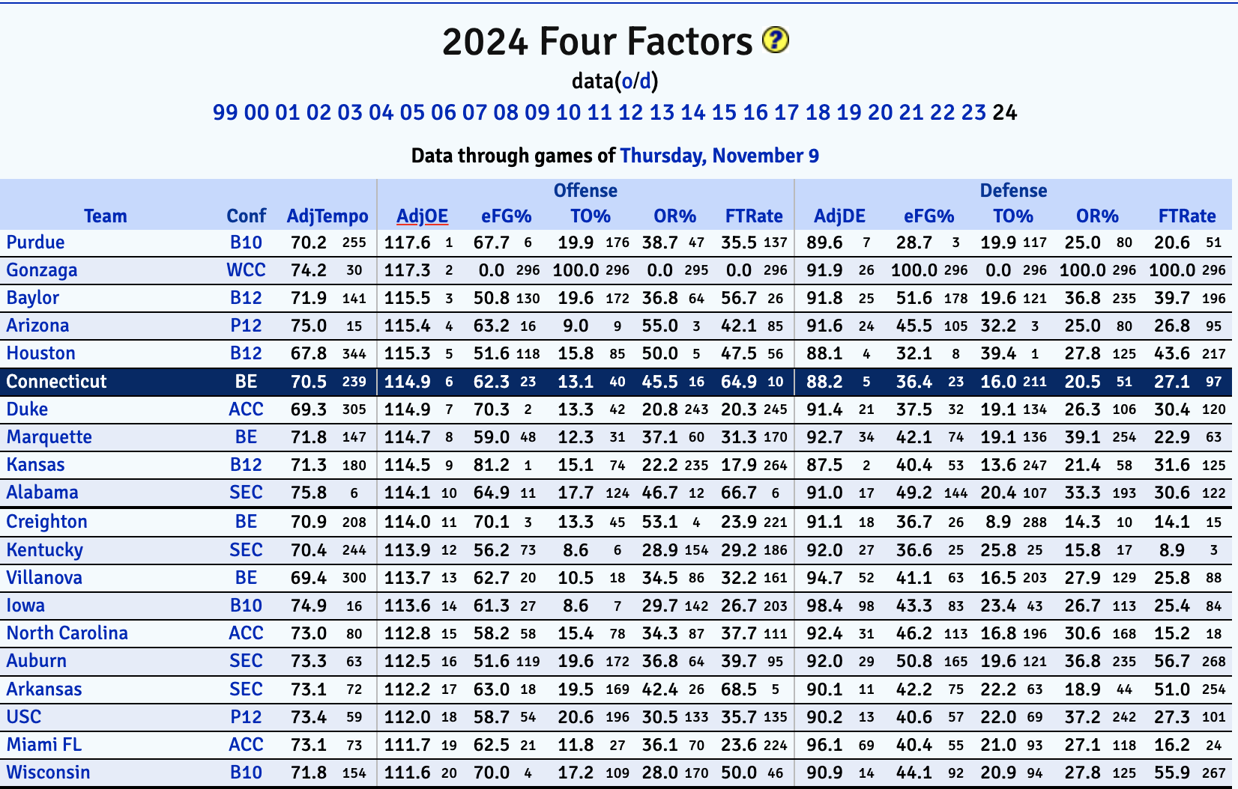
Kenpom
Kenpom.com, created and developed by Ken Pomeroy, is the leader in college basketball analytics
This data is used by scouts, coaches, and fans

Slide 9
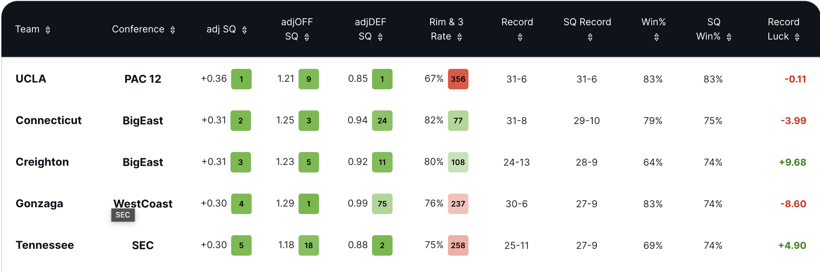
Shot Quality
Shotquality.com is another resource devoted to college basketball analytics
This site attempts to give more context to offensive statistics by examining the expected points a team would score based on their shot attempts

Slide 10
In House Analytics
Every single NBA team, and many college teams, also have in house analysts who create and develop their own internal metrics to evaluate teams and players
These metrics are often very proprietary and are based off a combination of publicly available data and internal data such as player tracking data

Slide 11
What I Look At
I have spent the last few months working as an analyst for our men’s basketball team
Some of the things I have done in my time there:
Create ways to analyze practice data like in-game data
Build up a database of player shots to evaluate efficiencies based on shot types
Use this database to create expected performance stats for in-game performance

Slide 12
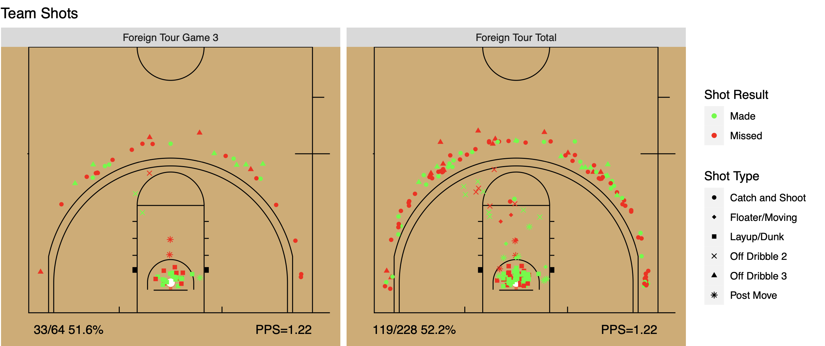
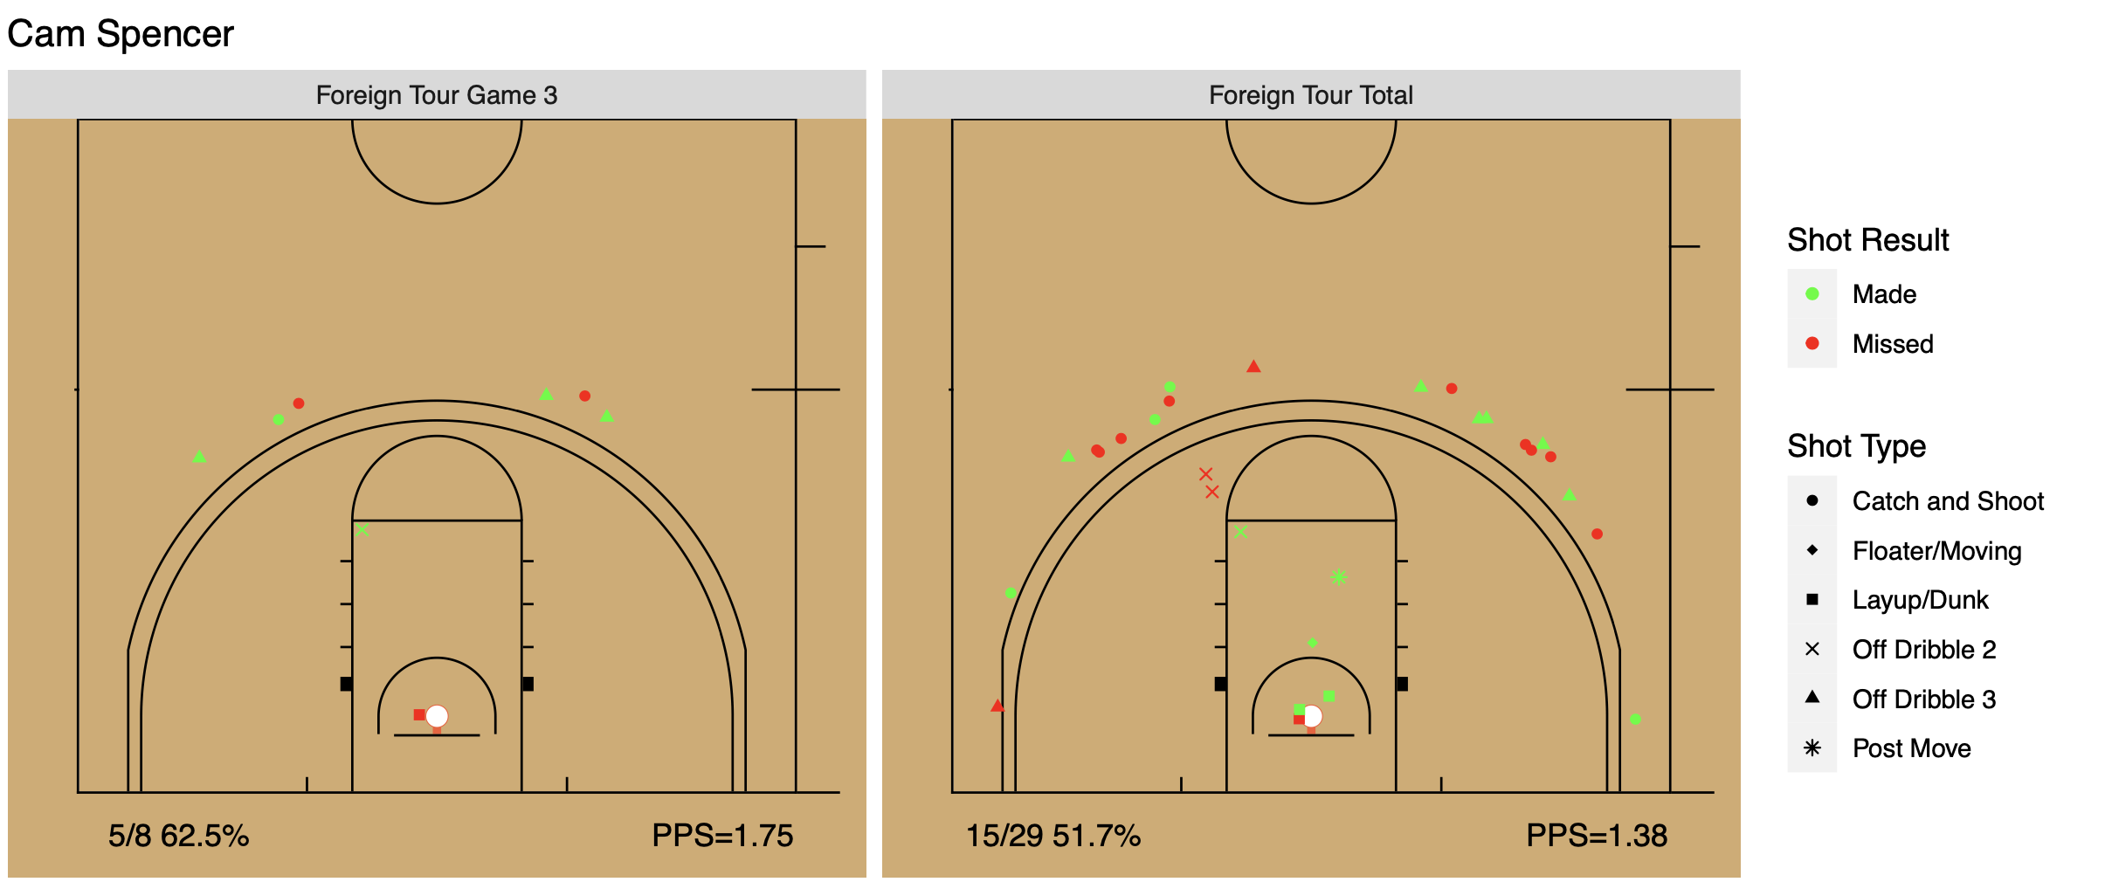
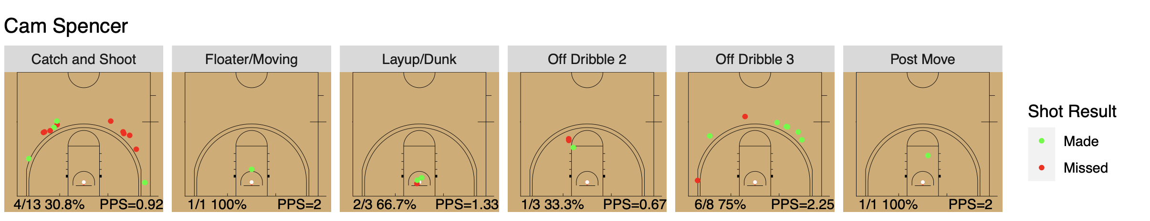
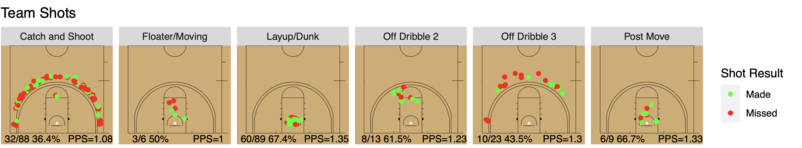

Slide 13
References
“2023 Team Standings.” Shot Quality, shotquality.com/team-standings. Accessed 10 November 2023.
Cheema, Ahmed. “The NBA’s Ongoing Three-Point Revolution.” The Spax. The Spax, 3 December 2019. https://www.thespax.com/nba/the-nbas-ongoing-three-point-revolution/. Accessed 13 November 2023.
Greenberg, Neil. “The Warriors Finally Have a True Challenger: the Rockets.” Washington Post. Washington Post, 11 December 2017, https://www.washingtonpost.com/news/fancy-stats/wp/2017/12/11/the-warriors-finally-have-a-true-challenger-the-rockets/. Accessed 10 November 2023.
“NBA Advanced Stats.” NBA, nba.com/stats/teams/advanced. Accessed 10 November 2023.
“NBA Team Regular Season Stats 2022-2023.” ESPN, espn.com/nba/stats/team/_/season/2023/seasontype/2. Accessed 10 November 2023.
Oliver, Dean. Basketball on Paper: Rules and Tools for Performance Analysis. 2004.
Pomeroy, Ken. “2024 Pomeroy College Basketball Ratings.” KenPom, kenpom.com. Accessed 10 November 2023.

